Slide 1

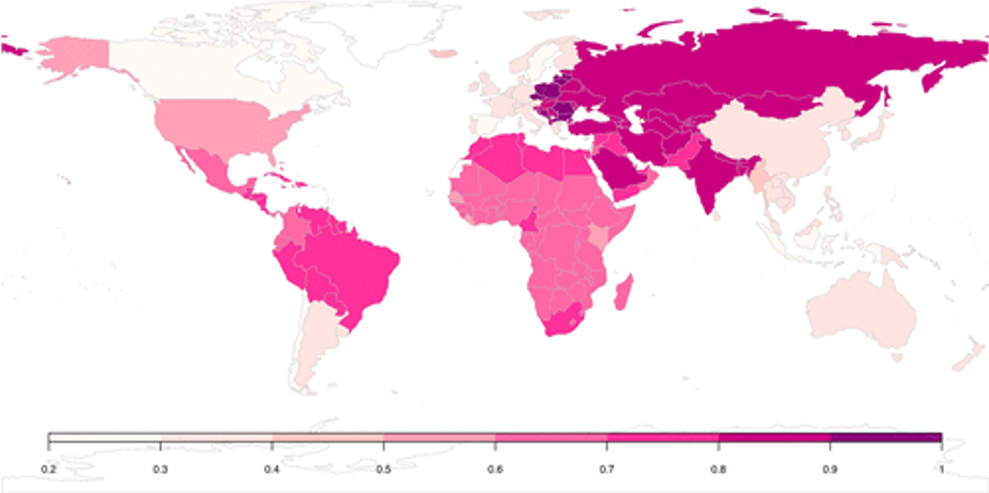
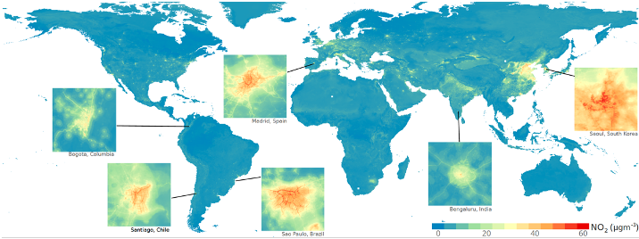
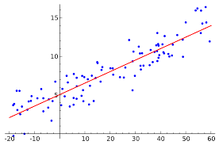
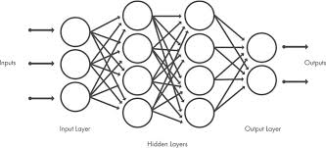
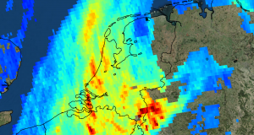
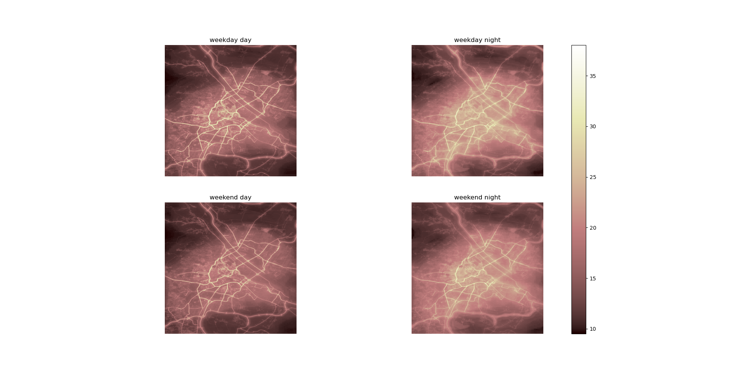


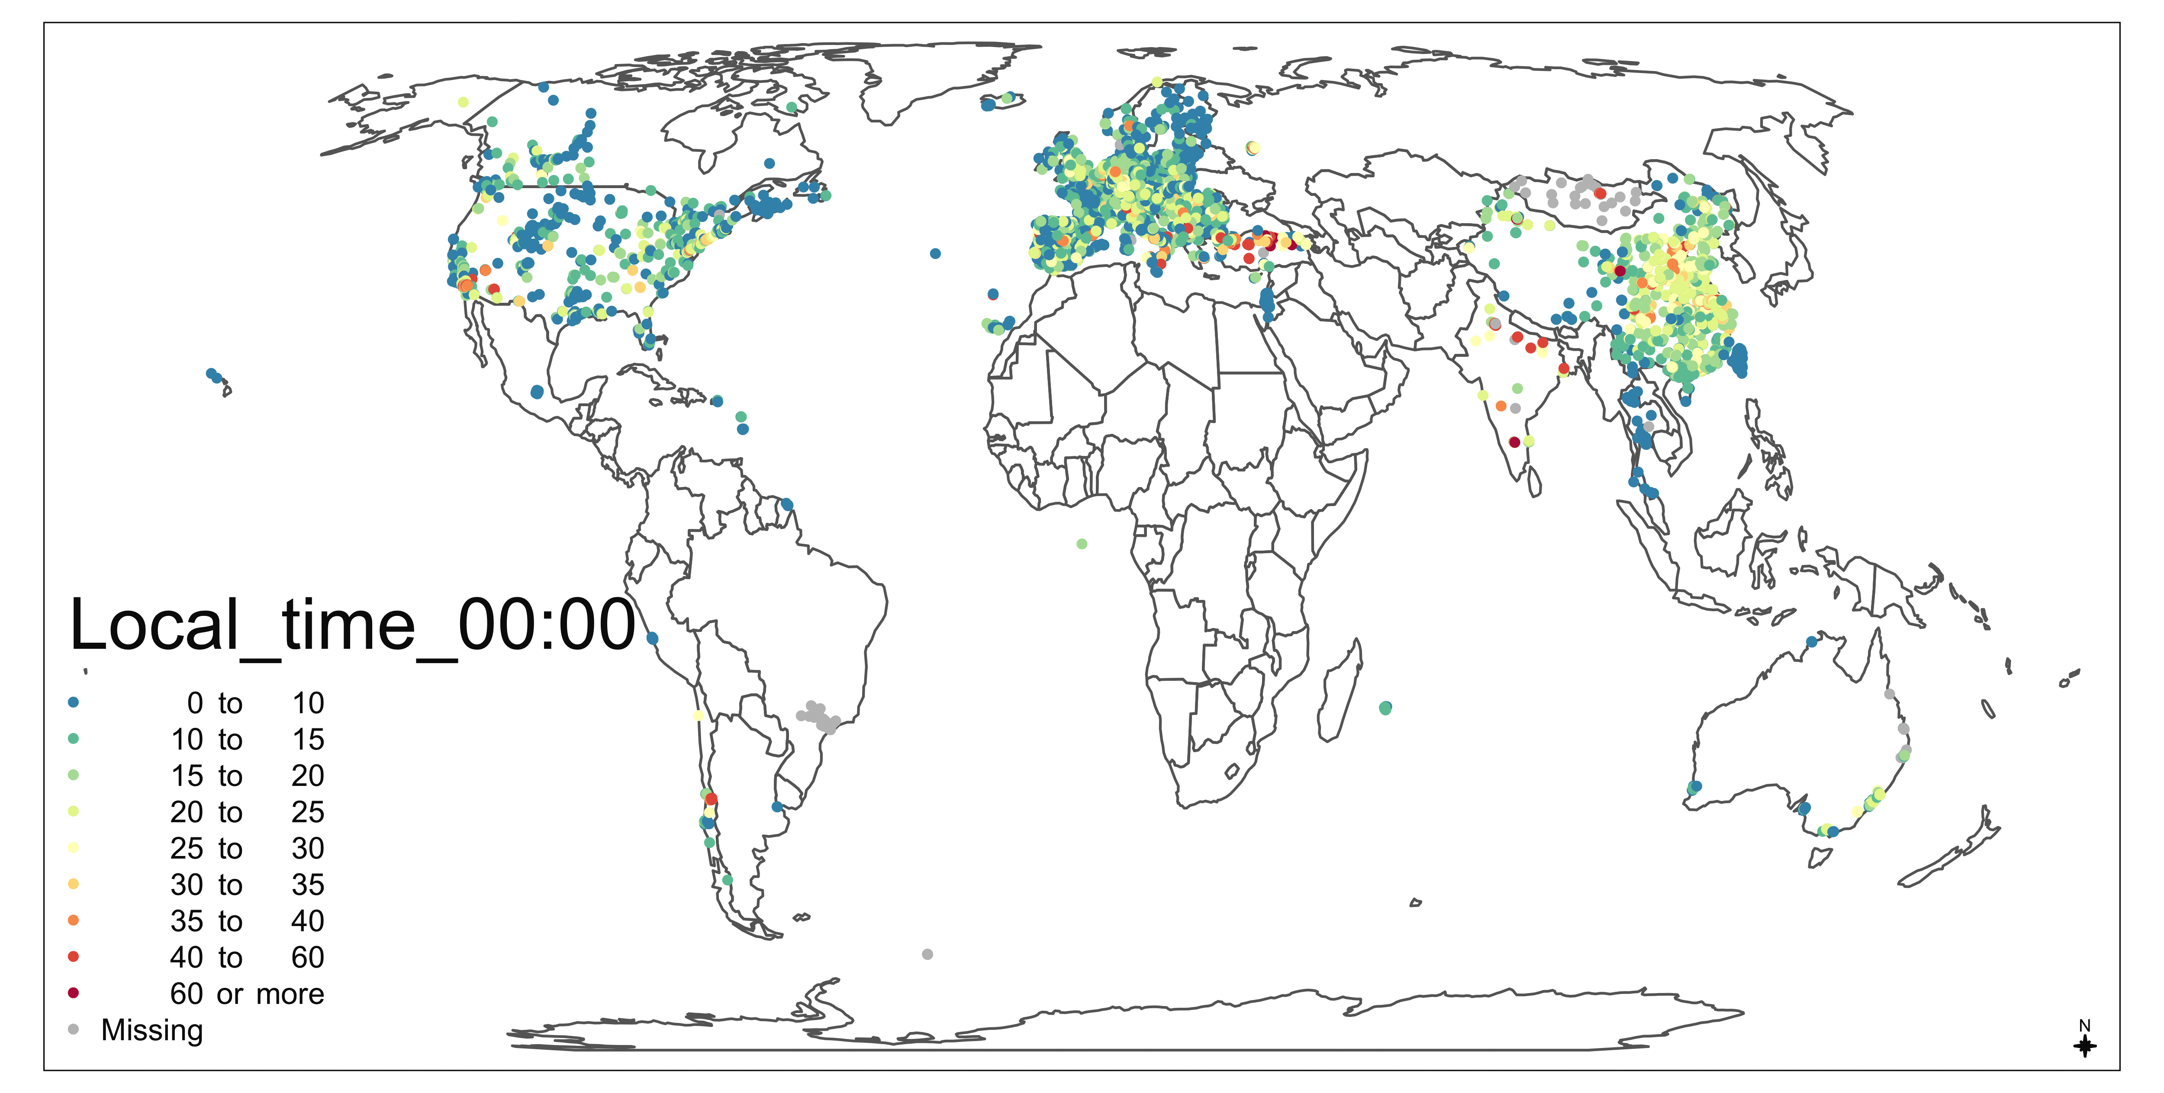



Global, high-resolution statistical modelling of NO₂
Meng Lu1, Oliver Schmitz1, Kees de Hoogh2,3, Perry Hystad4, Luke Knibbs5, Derek Karssenberg1
1 Department of Physical Geography, Utrecht University, the Netherlands
2 Swiss Tropical and Public Health Institute, Basel, Switzerland
3 University of Basel, Basel, Switzerland
4 Oregon state University, USA
5 The University of Queensland, Australia
Motivation Maps Methods
Ensemble tree vs. Regularised linear regression vs. Hierarchical modelling
Fig. 1
Global models Vs. National models
Fig. 2
Fig. 4
Data
Day-timg, Night-time, weekday, weekend
Fig. 3
Predictiors: road density, industry areas (OSM), ECMWF ERA5-Land, Radiation, Tropomi, Nightlight, DEM, Population …
Fig. 5
Slides and more: https://github.com/mengluchu/EGU2021 Contact: lumeng0312@gmail.com
Zoom chat (11:36-12:15): https://us04web.zoom.us/j/5849014992?pwd=NWZrdjBiUlIwa1REUVR5Q0plWGVNUT09

